Slide 1


Slide 2

OUR GUIDING PHILOSOPHY

Slide 3
LARSEN & TOUBRO CONSTRUCTIONS TEAM, JAMSHDPEDUR
STATIONERY AND OTHER ITEMS DISTRIBUTION AT SANKALP CENTRES

Slide 4
A NOBLE INITIATIVE FOR SANKALP KIDS ON 30.10.2015
Larsen & Toubro, one of India’s Industrial giant’s CSR wing visited Sankalp’s Centre on30st October 2015
The team visited Sankalp’s Imli Chauk & Aashiyana Moad, Saldih Basti Centres,
The session started with a brief interaction of Sankalp Kids with L&T Team
Stationery Distribution took place for the needy kids.

Slide 5
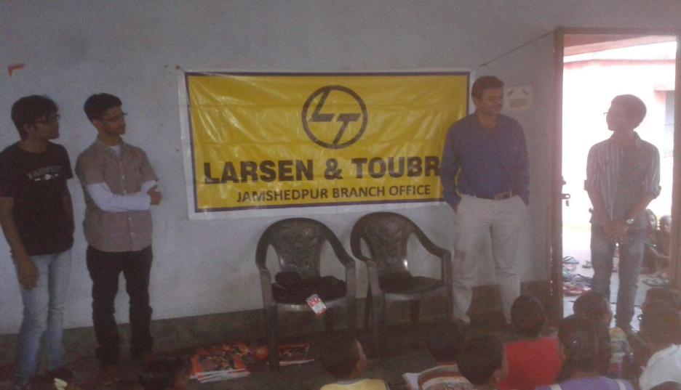
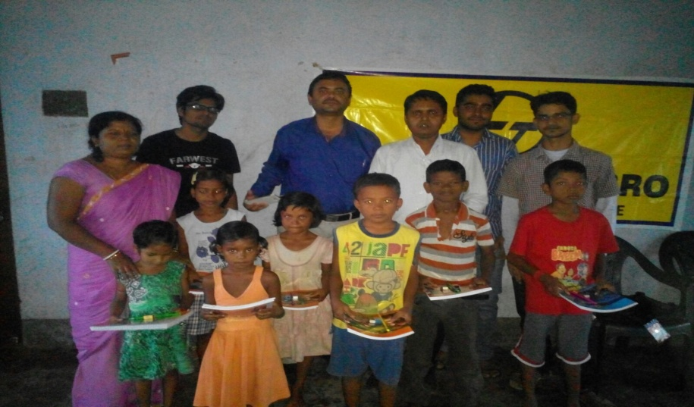
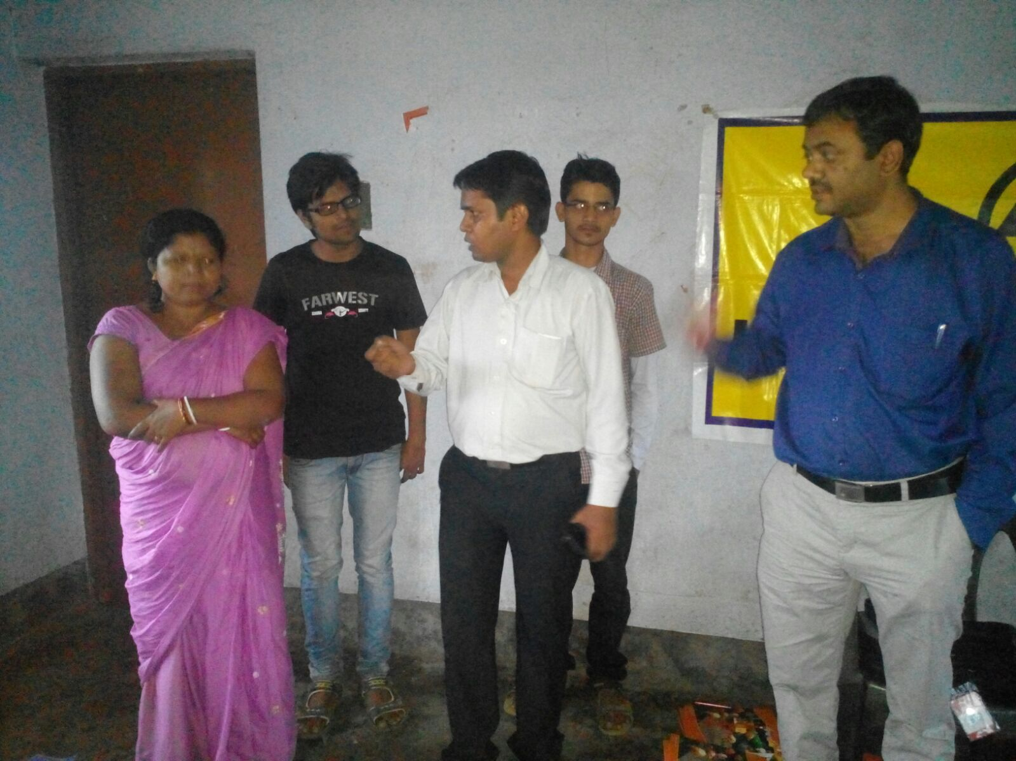
THE TEAM WITH A MISSION

Slide 6
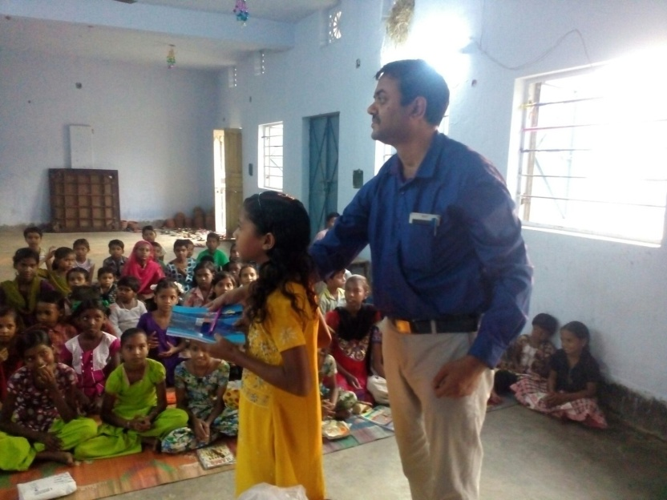
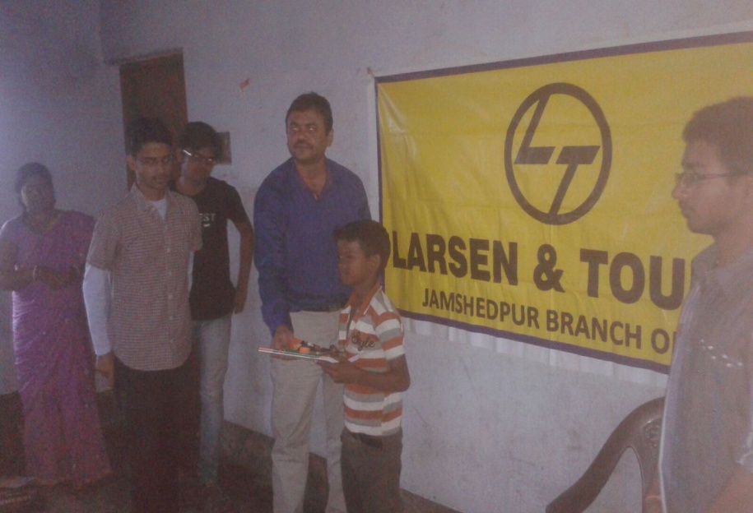
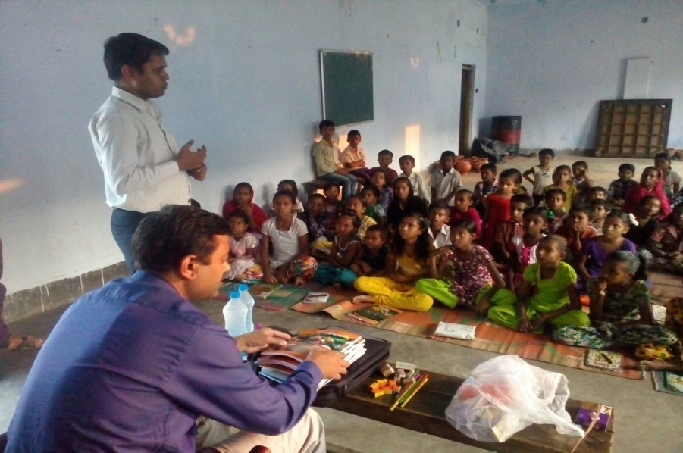
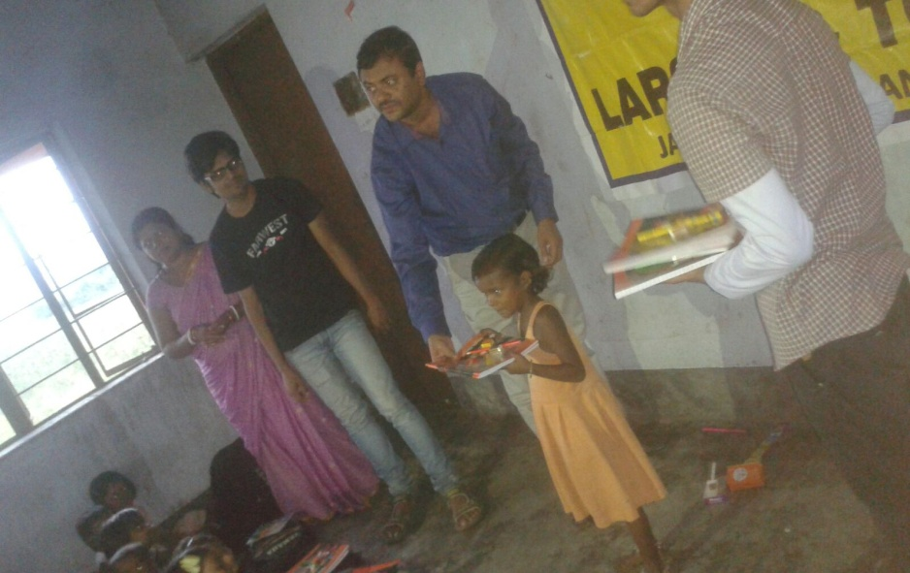
A HLEPING HAND, A RAY OF HOPE

Slide 7
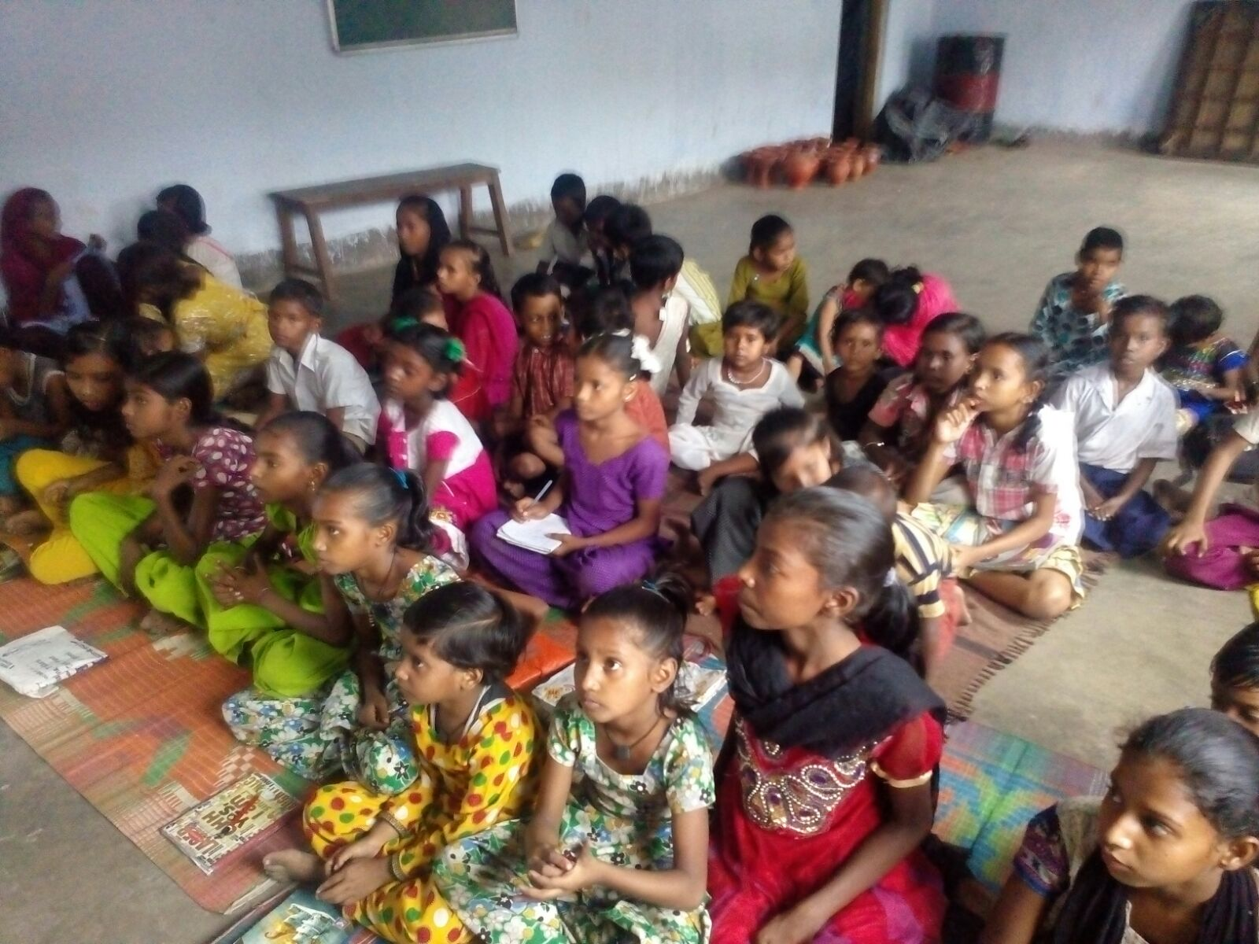
The future we hope to build !!!

Slide 8
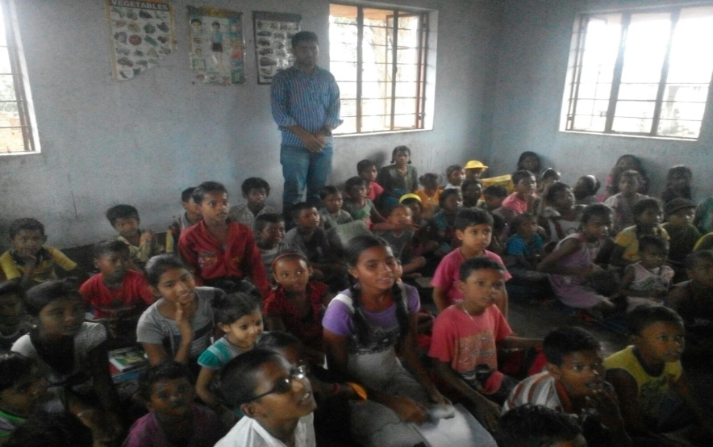
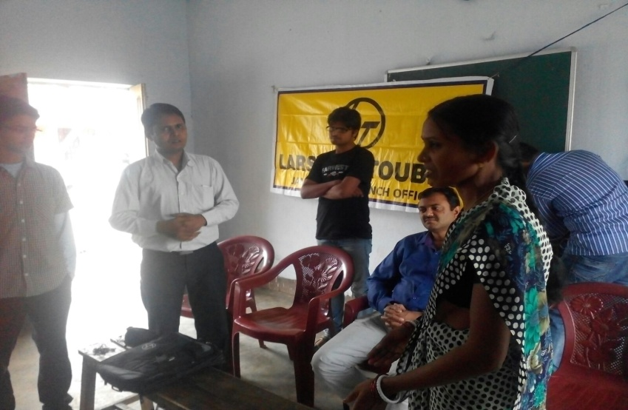
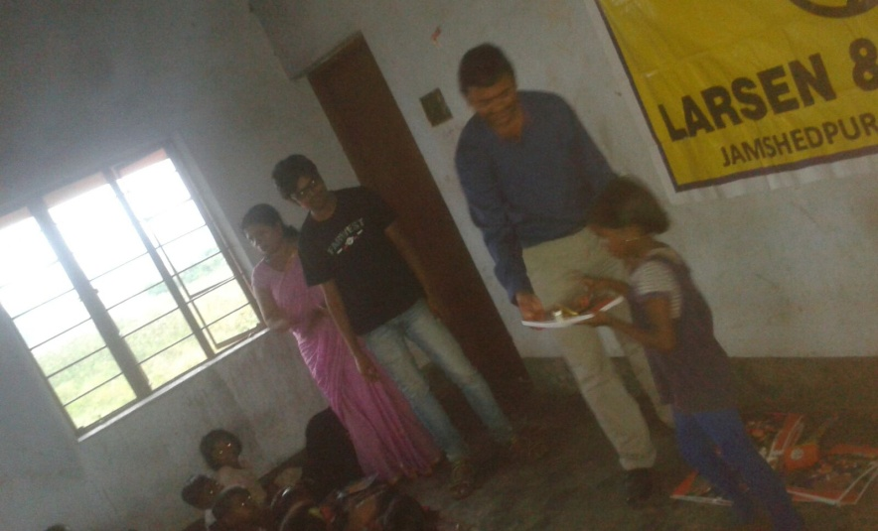
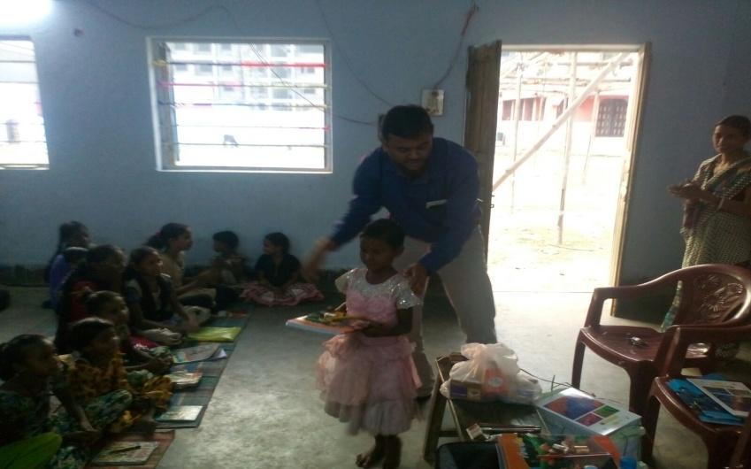
TO SERVE IS BEAUTIFUL, BUT ONLY IF IT IS DONE WITH JOY, WHOLE HEART AND A FREE MIND

Slide 9
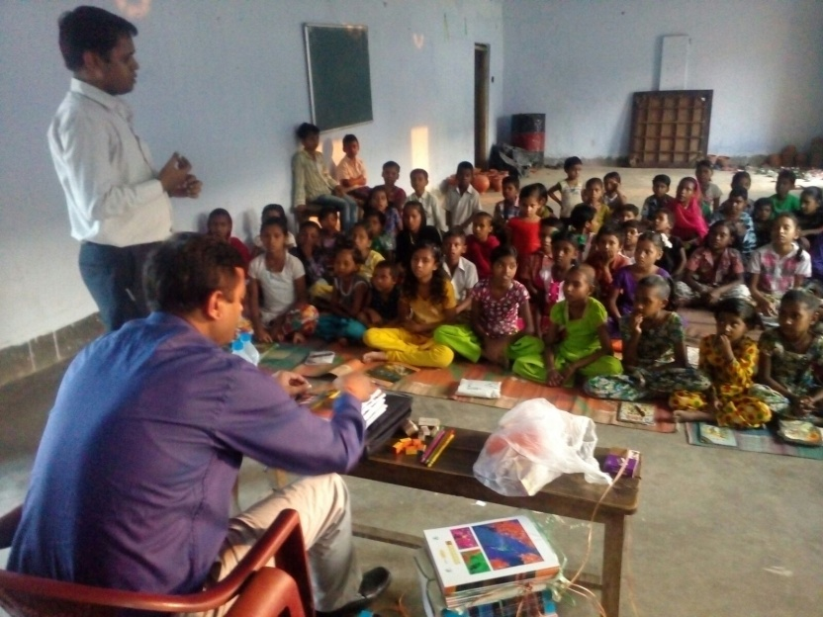
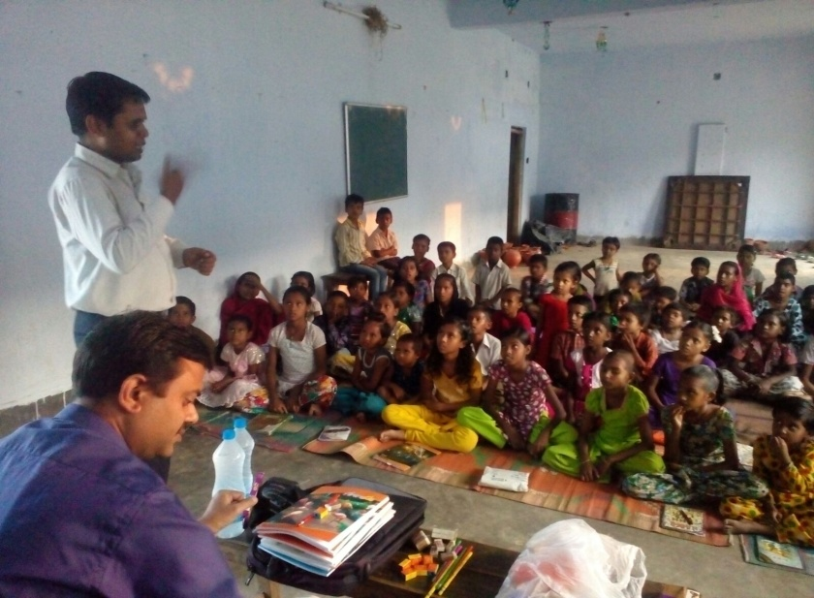
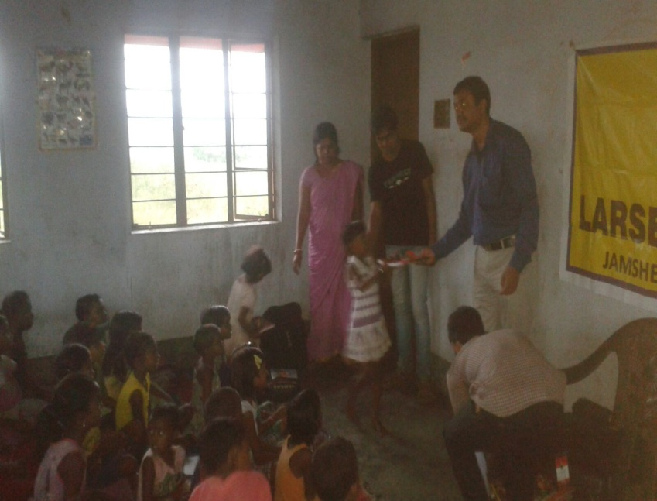
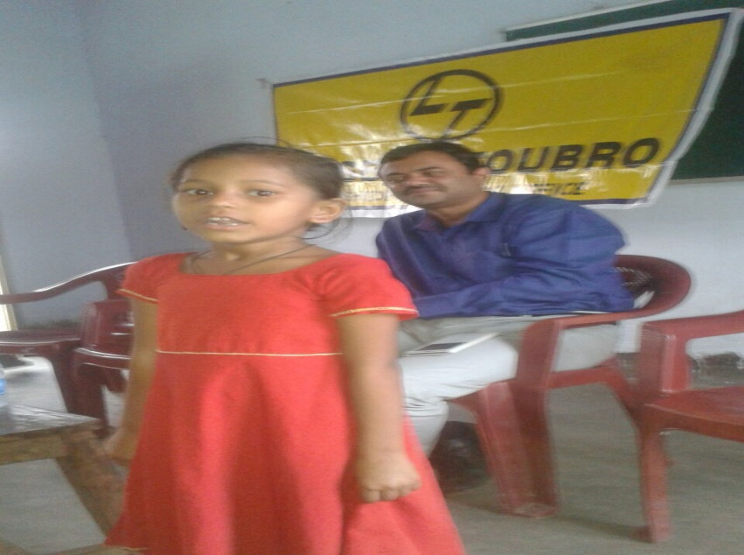
Change is going to happen and NOW is the time

Slide 10


Slide 11
"Change will not come if we wait for some other person or some other time. We are the ones we've been waiting for. We are the change that we seek.“

Slide 12
COME BE A PART OF THE JOURNEY
You can donate at any our centres by just making a call to Sankalp-A Pledge to Change volunteers.
All our centres are Adityapur based and run 6 days a week
You may donate books from
  Class 1-8- Course Text Books (Any Board)
  Story Books
  Unused stationery
  Any other items like bag, toys, uniforms etc.
Relevant Contact Nos. Are
  Subodh Kumar Das-9798756336
  Mayank Aggarwal -9031975746
  Suresh Pareek -7209632032
  Vikas Dixit -9472706225

Slide 13
ACCOUNT DETAILS FOR SUPPORT
Sankalp Account Details
  You can transfer funds online into our account:-
  “SANKALP” A/C No.-31114719936
  CIF No: 85757412911
  IFSC Code: SBIN0001882
  MICR Code: 831002004
  Branch code: (1882)
  Branch: SBI- RIT JAMSHEDPUR
    You may also visit our website and pay through online link available over it.
www.sankalpnitjamshedpur.org

Slide 14
“You have not lived today until you have done something for someone who can never repay you.”
www.sankalpnitjamshedpur.org

